Slide 1
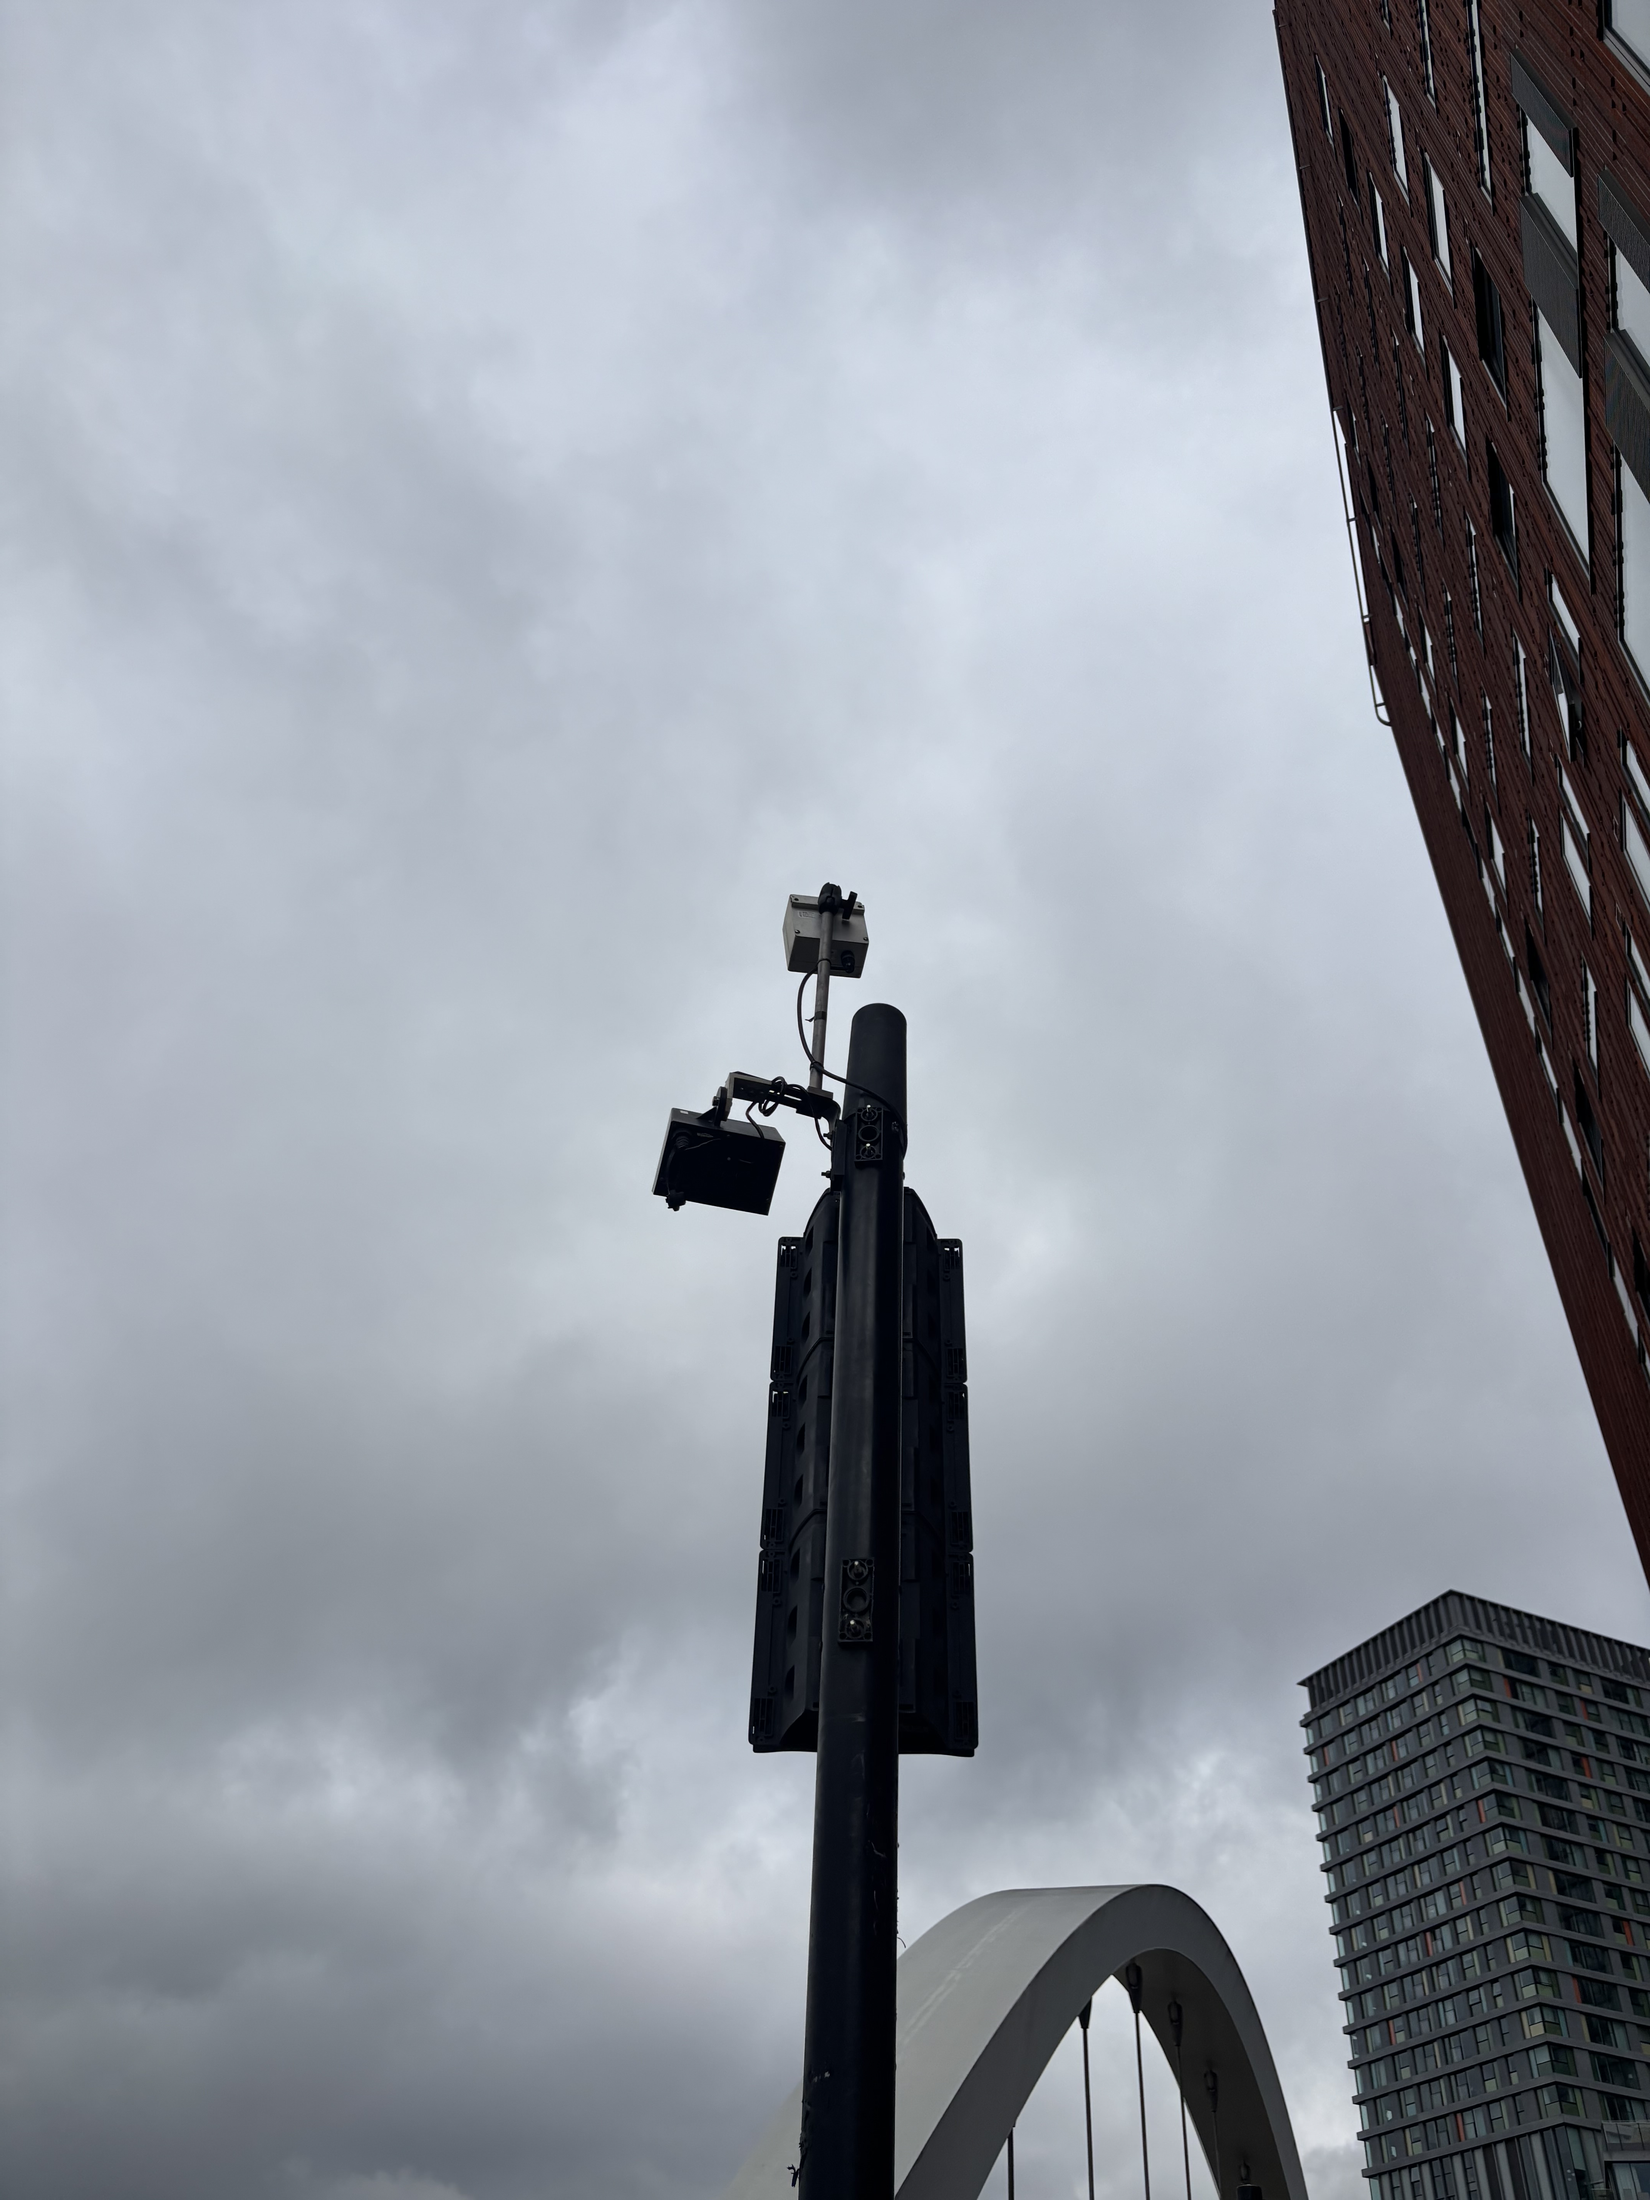
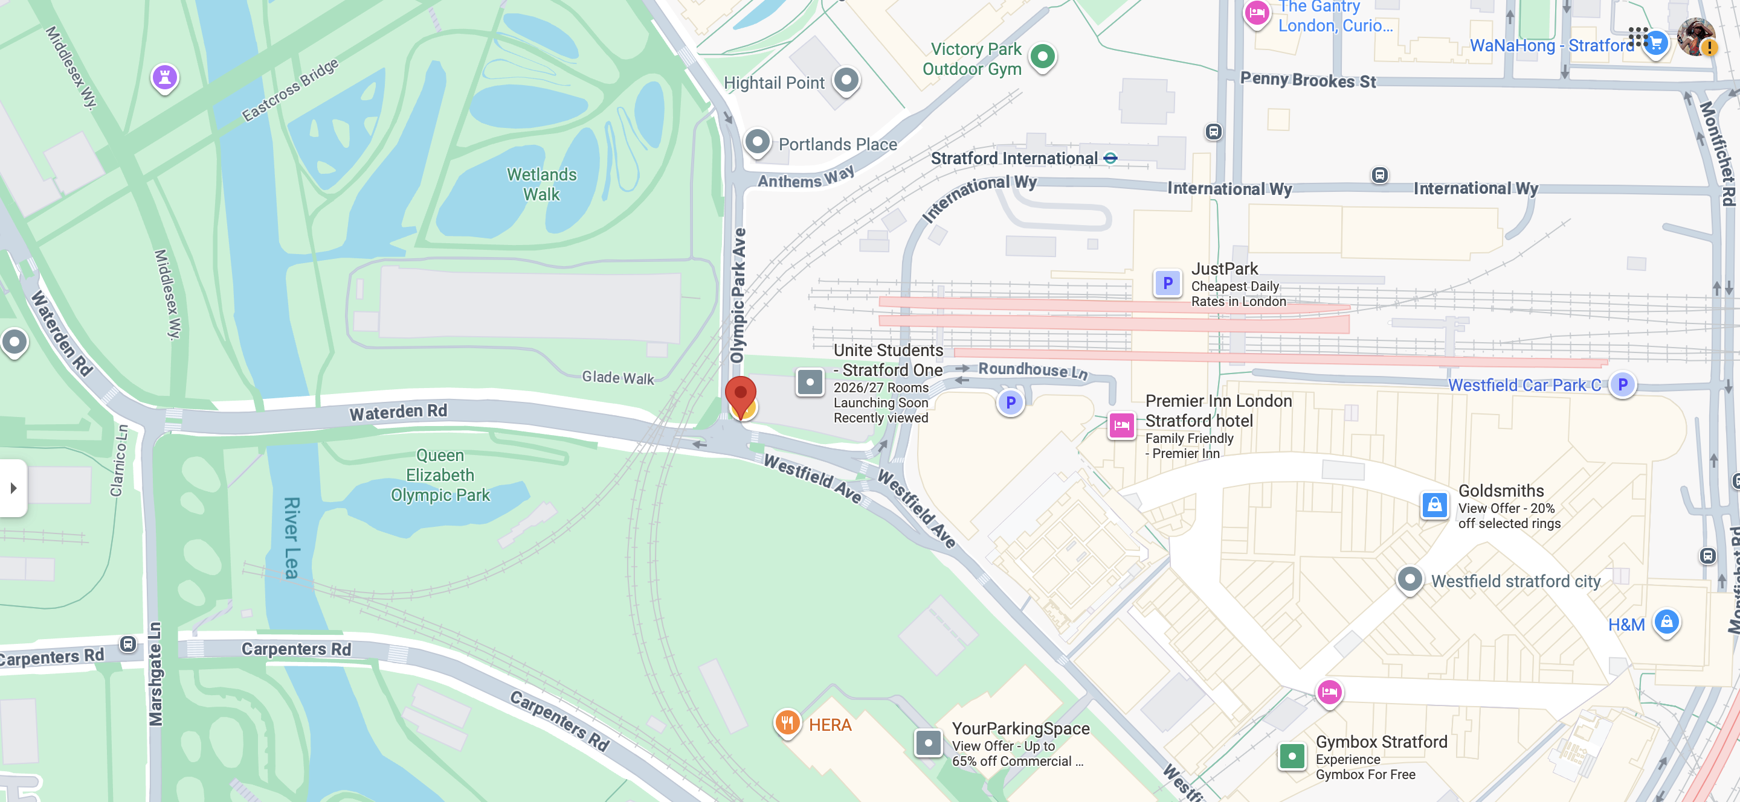
Motion Sensor
This motion sensor could be used to detect and observe the flow of the vehicles at the intersection.
This could be used to adjust the timing of traffic signals to optimize wait times. This sensor could also be used by local councils to monitor how the local population interacts with the intersection ; for example, if it is frequented by cyclists and needs a better bike line or by detecting cars running red lights .
Questions when visiting site?
How would this sensor be turned into a sensor that detects more than just motion ?
What other population monitoring features odes this sensor have ?
Location info:
@51°32'39.2"N 0°00'44.3"W
Olympic Park Ave, London E20
https://maps.app.goo.gl/mayeqqmqXx3Ddj4y9
what3words: /// ///tones.voted.vivid
Submitted: Yussr Osman Oct 2025
Notes:
.

